Slide 1
NT219- Cryptography
Week 11: Digital Signature
PhD. Ngoc-Tu Nguyen
tunn@uit.edu.vn

Slide 2
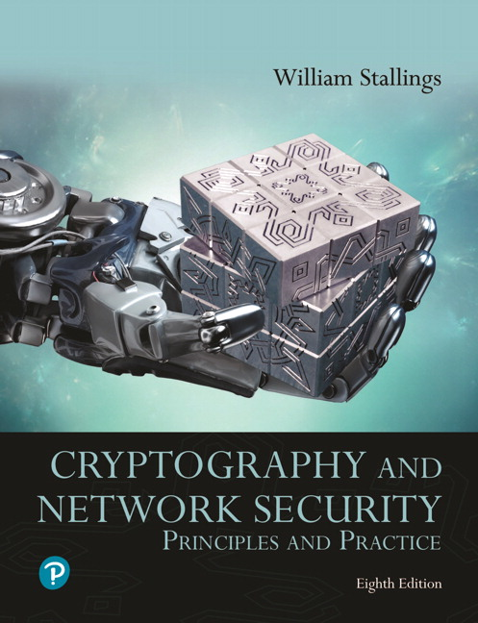
Textbooks and References
Text books
[1] Chapter 13.14

Slide 3
Outline
Motivations
Overview digital signature process
Elgamal digital signature scheme
Schnorr digital signature scheme
NIST digital signature schemes
  RSASSA-PKCS, RSASSA-PSS
  DSA, ECDSA
Public key distribution (X.509 digital certificates)
Notes:
Cipher=a secret system of writing;

Slide 4




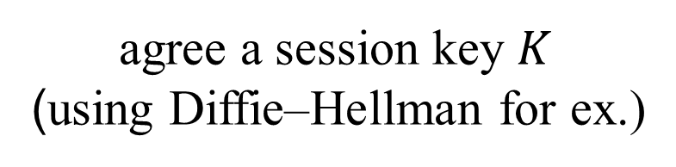

Motivations
How to ensure that the message is the original one?
How to verify that a message comes from the claimed sender?
Integrity?
Authentication?
MAC, HMAC
agree a session key $K$
(using Diffie–Hellman for ex.)
Alice
$$K$$
$$K$$
Bob
$$M, tag=MAC\left(K,M\right)(eg. H\left(K,M\right))$$
$$send M?$$
$$M^{′},tag$$
$MAC\left(K,M^{′}\right)=?tag=$ $MAC\left(K,M\right)$
$$M=M′$$

Slide 5


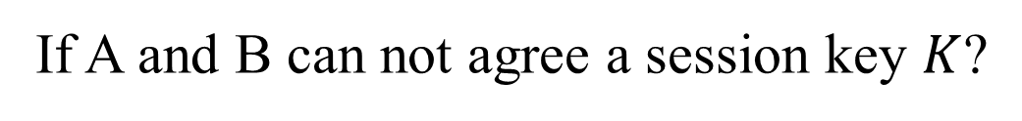


Motivations
How to ensure that the message is the original one?
How to verify that a message comes from the claimed sender?
Integrity?
Authentication?
MAC, HMAC
If A and B can not agree a session key $K$?
Alice
Bob
$$M, tag=HMAC\left(K,M\right)=H(K,M)$$
$$send M?$$
$$M^{′},tag$$
$H\left(K,M^{′}\right)=tag=$ $H\left(K,M\right)?$
$$M=M′$$

Slide 6










Motivations
How to ensure that the message is the original one?
How to verify that a message comes from the claimed sender?
Integrity?
Authentication?
B
using digital signature
$$PK_{A}$$
D
$$(PK_{A},{SK}_{A})$$
A
$$⋯$$
C
$$send M?$$
$$M, tag=sign\left({SK}_{A},M\right)$$
$$M^{′},tag$$
$$verify\left(PK_{A},M′,tag\right)?$$
$$M=M′$$

Slide 7
Digital Signature Properties
Goals:
  It must be verifiable the author (signer);
  It must be verifiable the content integrity and time of the signature;
  It must be verifiable by third parties (to resolve disputes);

Slide 8
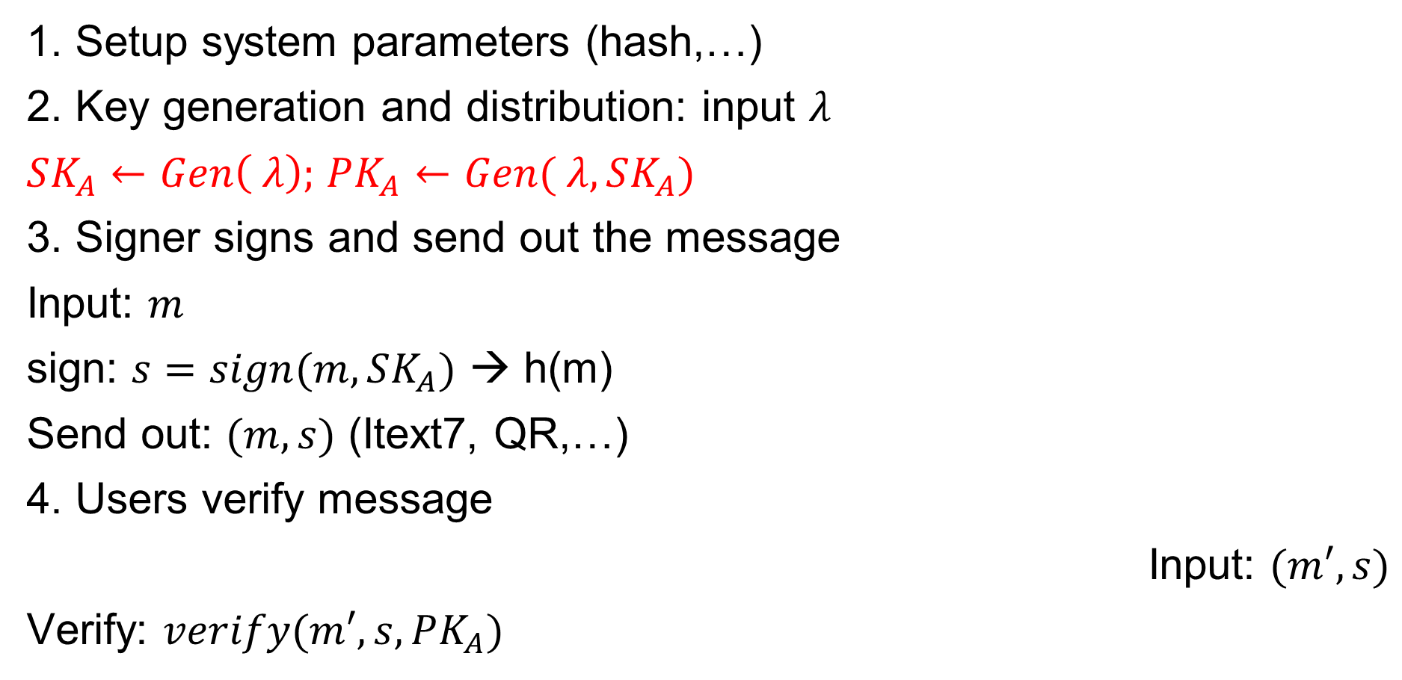

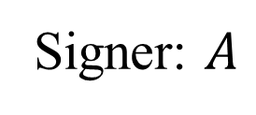


Digital signature algorithms
Signer: $A$
1. Setup system parameters (hash,…)
2. Key generation and distribution: input $λ$
$SK_{A}←Gen\left( λ\right);$ $PK_{A}$ $←Gen( λ,SK_{A})$
3. Signer signs and send out the message
Input: $m$
sign: $s=sign(m,SK_{A})$ → h(m)
Send out: $(m,s)$ (Itext7, QR,…)
4. Users verify message
Input: $(m′,s)$
Verify: $verify(m′,s,PK_{A})$
$$m$$
$$(m,tag=s)$$
$$PK_{A}$$
Users
Notes:
Cipher=a secret system of writing;

Slide 9
Outline
Motivations
Overview of the digital signature process
Elgamal digital signature scheme
Schnorr digital signature scheme
NIST digital signature schemes
  RSASSA-PKCS, RSASSA-PSS
  DSA, ECDSA
Public key distribution (X.509 digital certificates)

Slide 10
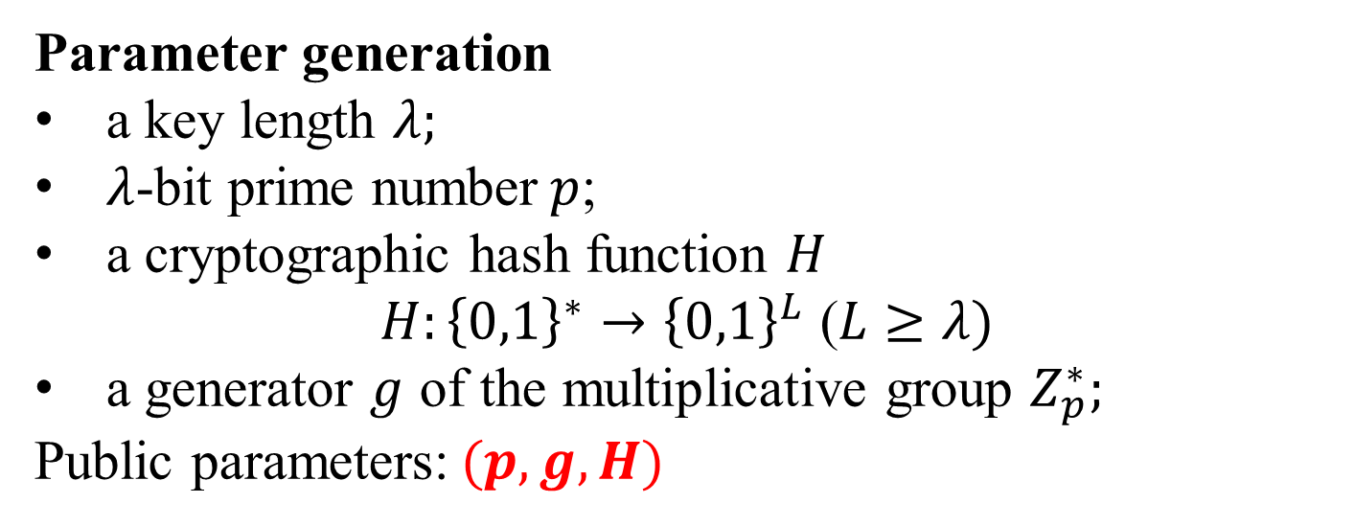
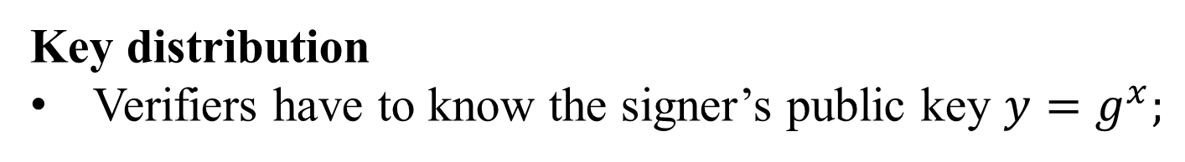
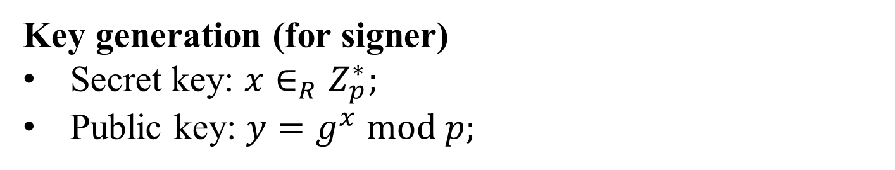
ElGamal Digital Signature
Parameter generation
a key length $λ;$
$λ$-bit prime number$p$;
a cryptographic hash function $H$
$H:{\left\{0,1\right\}}^{∗}→{\left\{0,1\right\}}^{L}$ ($L≥λ)$
a generator $g$ of the multiplicative group $Z_{p}^{∗};$
Public parameters:$(p, g, H)$
Key generation (for signer)
Secret key: ${x∈_{R}Z}_{p}^{∗};$
Public key: $y=g^{x} mod p;$
Key distribution
Verifiers have to know the signer’s public key $y=g^{x};$

Slide 11
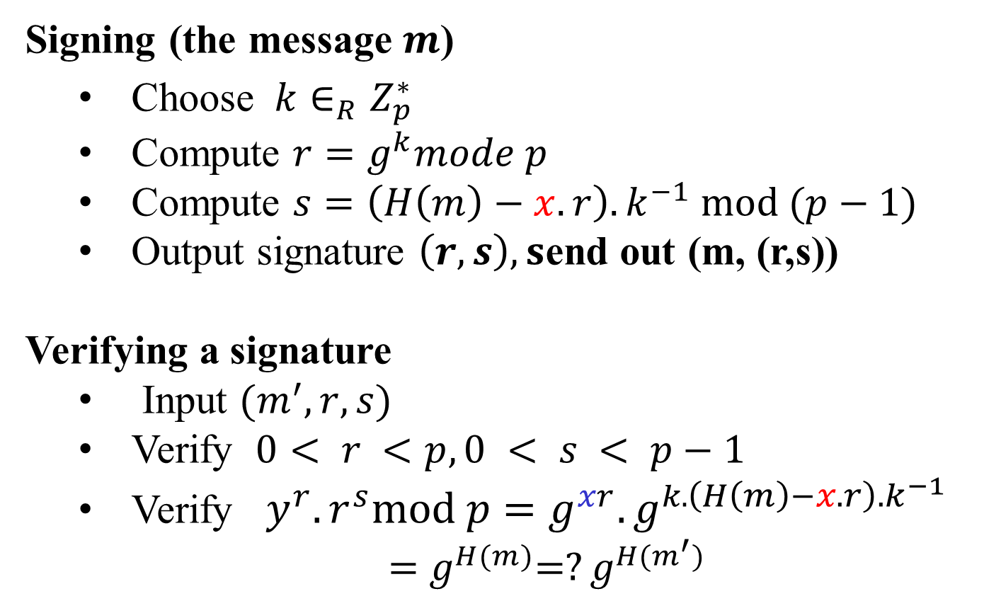
ElGamal Digital Signature
Signing (the message $m$)
  Choose ${k∈_{R}Z}_{p}^{∗}$
  Compute $r=g^{k}mode p$
  Compute $s=\left(H\left(m\right)−x.r\right).k^{−1} mod (p−1)$
  Output signature $\left(r, s\right), s$end out (m, (r,s))
Verifying a signature
  Input $(m^{′},r, s)$
  Verify $0< r <p, 0 < s < p−1$
  Verify $y^{r}.r^{s}mod p=g^{xr}.g^{k.\left(H\left(m\right)−x.r\right).k^{−1}}$
    ${=g}^{H(m)}=?g^{H(m^{′})}$
In public key
Secret key

Slide 12
Outline
Motivations
Overview of the digital signature process
Elgamal digital signature scheme
Schnorr digital signature scheme
NIST digital signature schemes
  RSASSA-PKCS, RSASSA-PSS
  DSA, ECDSA
Public key distribution (X.509 digital certificates)

Slide 13
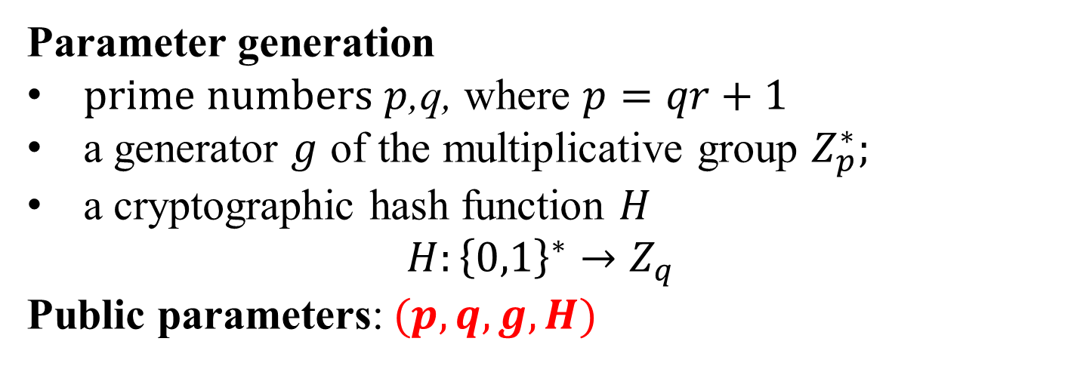
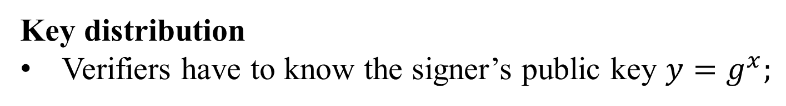
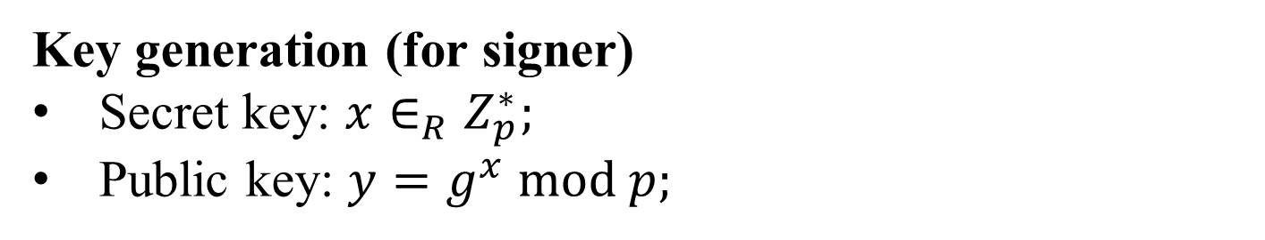
Schnorr Digital Signature
Parameter generation
$prime numbers p$,q, where $p=qr+1$
a generator $g$ of the multiplicative group $Z_{p}^{∗};$
a cryptographic hash function $H$
$$H:{\left\{0,1\right\}}^{∗}→Z_{q}$$
Public parameters:$(p, q,g, H)$
Key generation (for signer)
Secret key: ${x∈_{R}Z}_{p}^{∗};$
Public key: $y=g^{x} mod p;$
Key distribution
Verifiers have to know the signer’s public key $y=g^{x};$

Slide 14
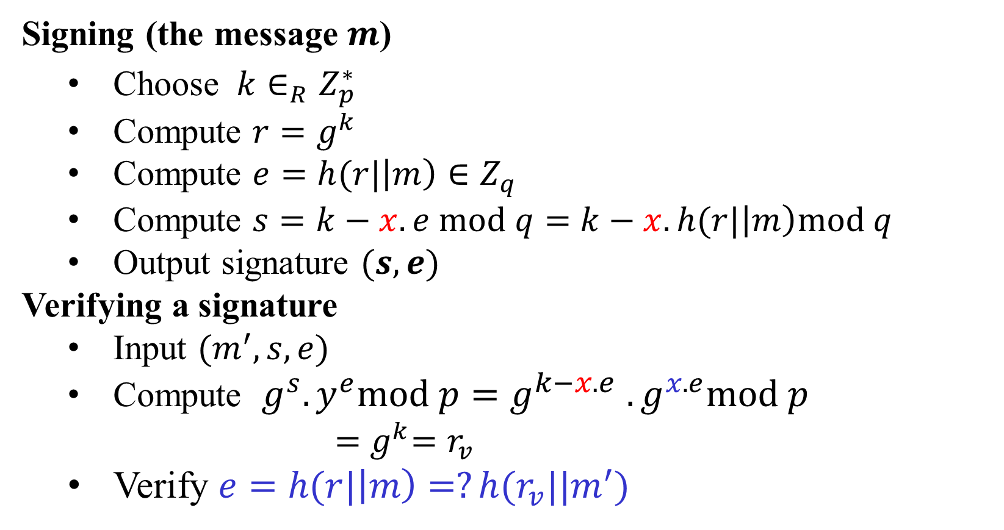
Schnorr Digital Signature
Signing (the message $m$)
  Choose ${k∈_{R}Z}_{p}^{∗}$
  Compute $r=g^{k}$
  Compute $e=h(r|\left|m\right)∈Z_{q}$
  Compute $s=k−x.e mod q=$ $k−x.h(r|\left|m\right)mod q$
  Output signature $(s,e)$
Verifying a signature
  Input $(m^{′},s, e)$
  Compute $g^{s}.y^{e}mod p=g^{k−x.e }.g^{x.e}mod p$
    ${=g}^{k}=r_{v}$
  Verify $e=h(r|\left|m\right)=?h(r_{v}||m^{′})$
Secret key
In public key

Slide 15
Outline
Motivations
Overview of the digital signature process
Elgamal digital signature scheme
Schnorr digital signature scheme
NIST digital signature schemes
  RSASSA-PKCS, RSASSA-PSS
  DSA, ECDSA
Public key distribution (X.509 digital certificates)

Slide 16
N I S T Digital Signature Algorithm
Published by N I S T as Federal Information Processing Standard F I P S 186 (1994)
  https://nvlpubs.nist.gov/nistpubs/Legacy/FIPS/fipspub186.pdf
  Makes use of the Secure Hash Algorithm (S H A)
The latest version, F I P S 186-4 (2013)
  https://nvlpubs.nist.gov/nistpubs/FIPS/NIST.FIPS.186-4.pdf
Current version F I P S 186-5 (2023)
  https://csrc.nist.gov/publications/detail/fips/186/5/final
F I P S 203, 204 (2024)

Slide 17
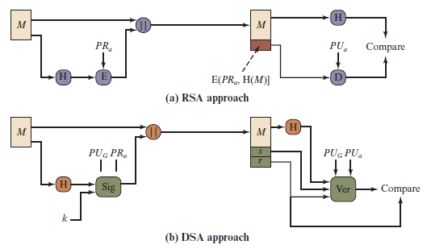
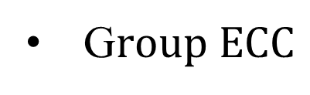
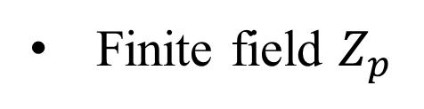
Two Approaches to Digital Signatures
Finite field $Z_{p}$
G$roup ECC$
Notes:
The DSA uses an algorithm that is designed to provide only the digital signature
function. Unlike RSA, it cannot be used for encryption or key exchange.
Nevertheless, it is a public-key technique.
Figure 13.2 contrasts the DSA approach for generating digital signatures to
that used with RSA. In the RSA approach, the message to be signed is input to a
hash function that produces a secure hash code of fixed length. This hash code is
then encrypted using the sender’s private key to form the signature. Both the message
and the signature are then transmitted. The recipient takes the message and
produces a hash code. The recipient also decrypts the signature using the sender’s
public key. If the calculated hash code matches the decrypted signature, the signature
is accepted as valid. Because only the sender knows the private key, only the
sender could have produced a valid signature.
The DSA approach also makes use of a hash function. The hash code is provided
as input to a signature function along with a random number k generated
for this particular signature. The signature function also depends on the sender’s
private key (PR_{a} ) and a set of parameters known to a group of communicating principals.
We can consider this set to constitute a global public key (PU_{G} ). The result
is a signature consisting of two components, labeled s and r .
At the receiving end, the hash code of the incoming message is generated. This
plus the signature is input to a verification function. The verification function also
depends on the global public key as well as the sender’s public key (PU_{a} ), which
is paired with the sender’s private key. The output of the verification function is a
value that is equal to the signature component r if the signature is valid. The signature
function is such that only the sender, with knowledge of the private key, could
have produced the valid signature.

Slide 18
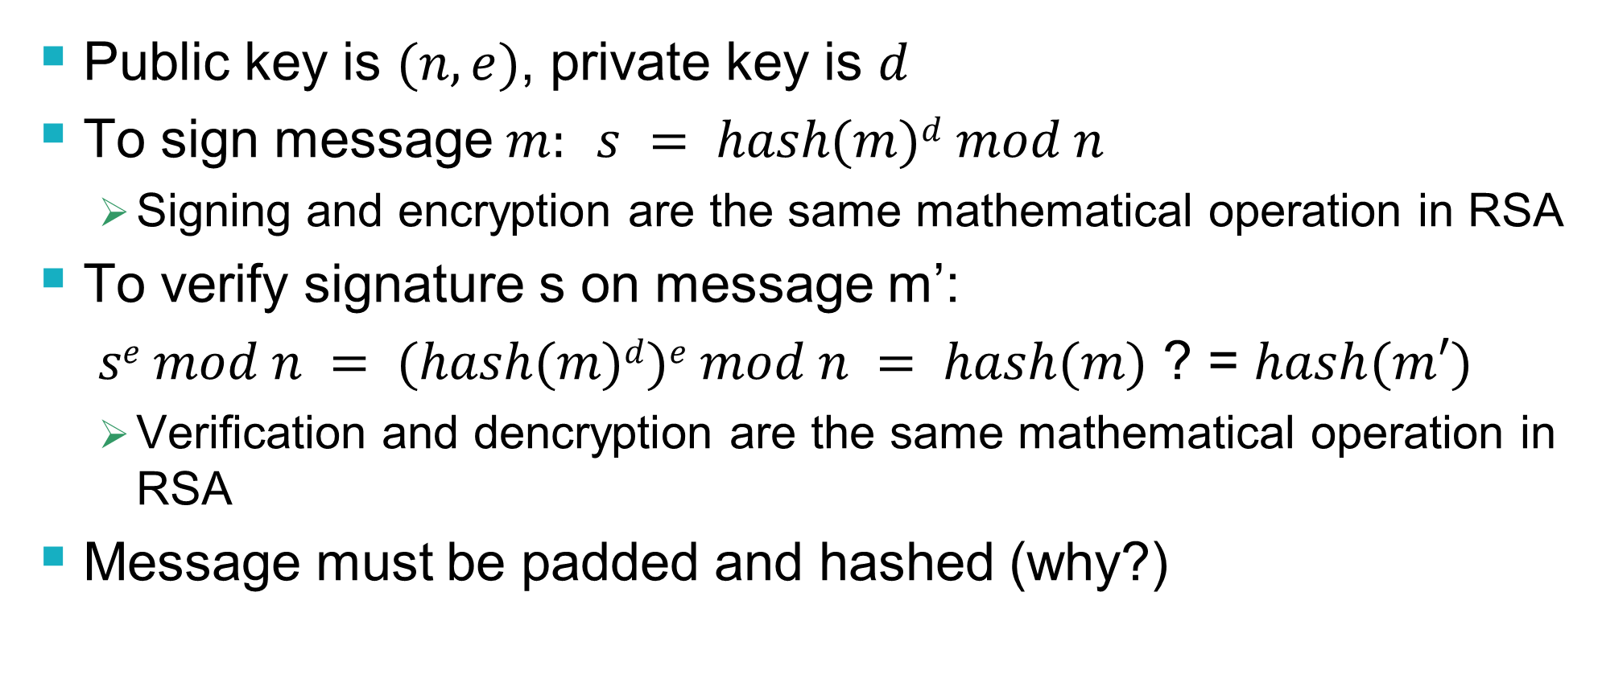
RSASSA Signatures
Raw version
Public key is $(n,e)$, private key is $d$
To sign message $m:$ $s = hash(m)d mod n$
  Signing and encryption are the same mathematical operation in RSA
To verify signature s on message m’:
$se mod n = (hash(m)d)e mod n = hash(m)$ ? = $hash(m′)$
  Verification and dencryption are the same mathematical operation in RSA
Message must be padded and hashed (why?)

Slide 19
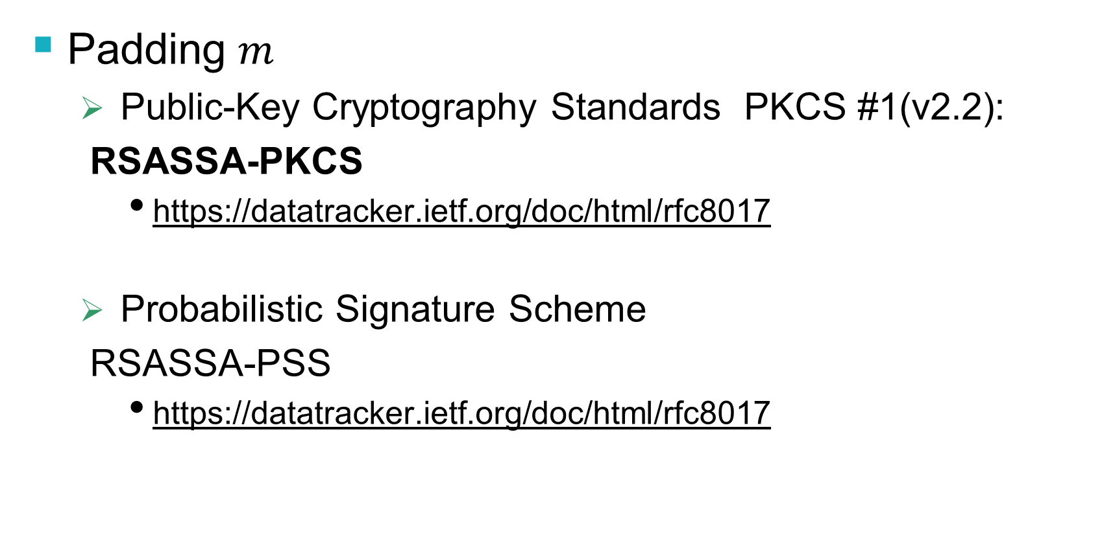
RSASSA Signatures
Padding $m$
  Public-Key Cryptography Standards PKCS #1(v2.2):
  RSASSA-PKCS
    https://datatracker.ietf.org/doc/html/rfc8017
  Probabilistic Signature Scheme
  RSASSA-PSS
    https://datatracker.ietf.org/doc/html/rfc8017

Slide 20

RSASSA-PKCS
  PKCS padding
(M, emLen)
EM = 0x00 || 0x01 || 0xff… 0xff || 0x00 || DigestInfo value ||H(M)
RSA encrypt
$$signature: s$$
MD2: (0x)30 20 30 0c 06 08 2a 86 48 86 f7 0d 02 02 05 00 04 10 || H(M)
MD5: (0x)30 20 30 0c 06 08 2a 86 48 86 f7 0d 02 05 05 00 04 10 || H(M)
SHA-1: (0x)30 21 30 09 06 05 2b 0e 03 02 1a 05 00 04 14 || H(M)
SHA-224: (0x)30 2d 30 0d 06 09 60 86 48 01 65 03 04 02 04 05 00 04 1c || H(M)
SHA-256: (0x)30 31 30 0d 06 09 60 86 48 01 65 03 04 02 01 05 00 04 20 || H(M)
SHA-384: (0x)30 41 30 0d 06 09 60 86 48 01 65 03 04 02 02 05 00 04 30 || H(M)
SHA-512: (0x)30 51 30 0d 06 09 60 86 48 01 65 03 04 02 03 05 00 04 40 || H(M)
SHA-512/224: (0x)30 2d 30 0d 06 09 60 86 48 01 65 03 04 02 05 05 00 04 1c || H(M)

Slide 21
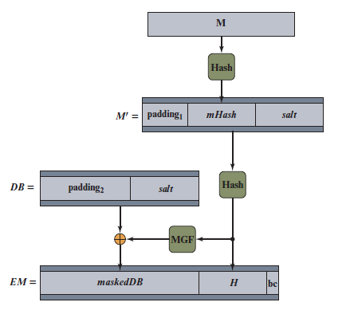

RSASSA-PSS Encoding
Probabilistic padding
(0x)00 00 00 00 00 00 00 00
(0x) 00 ..00 01
MGF: a hash function
(0x)bc
RSA encrypt
$$signature: s$$
Notes:
The first stage in generating an RSA-PSS signature of a message
M is to generate from M a fixed-length message digest, called an encoded message
(EM ). Figure 13.6 illustrates this process.
We make several comments about the complex nature of this message digest
algorithm. All of the RSA-based standardized digital signature schemes involve appending
one or more constants (e.g., padding₁ and padding₂ ) in the process of forming
the message digest. The objective is to make it more difficult for an adversary to
find another message that maps to the same message digest as a given message or to
find two messages that map to the same message digest. RSA-PSS also incorporates
a pseudorandom number, namely the salt. Because the salt changes with every use,
signing the same message twice using the same private key will yield two different
signatures. This is an added measure of security.

Slide 22
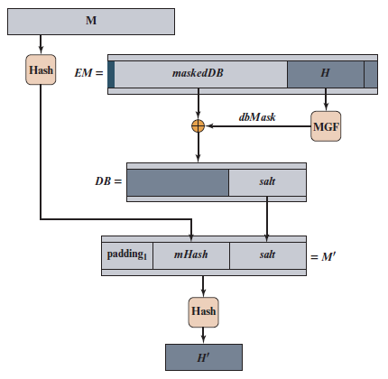




R S ASSA-P S S verifying
$$s$$
$$(M^{∗},s)$$
$$M^{∗}$$
RSA decrypt
H(M*)=?H(M)=mHash
$$?$$
Notes:
Figure 13.7 RSA-PSS EM Verification
The shaded boxes labeled H and H′ correspond, respectively, to the value contained in the decrypted signature and the value generated from the message M associated with the signature. The remaining three shaded areas contain values generated from the decrypted signature and compared to known constants. We can now see more clearly the different roles played by the constants and the pseudorandom value salt, all of which are embedded in the EM generated by the signer. The constants are known to the verifier, so that the computed constants can be compared to the known constants as an additional check that the signature is valid (in addition to comparing H and H′). The salt results in a different signature every time a given message is signed with the same private key. The verifier does not know the value of the salt and does not attempt a comparison. Thus, the salt plays a similar role to the pseudorandom variable k in the NIST DSA and in ECDSA. In both of those schemes, k is a pseudorandom number generated by the signer, resulting in different signatures from multiple signings of the same mes- sage with the same private key. A verifier does not and need not know the value of k.

Slide 23
Outline
Motivations
Overview of the digital signature process
Elgamal digital signature scheme
Schnorr digital signature scheme
NIST digital signature schemes
  RSASSA-PKCS, RSASSA-PSS
  DSA,ECDSA
Public key distribution (X.509 digital certificates)

Slide 24
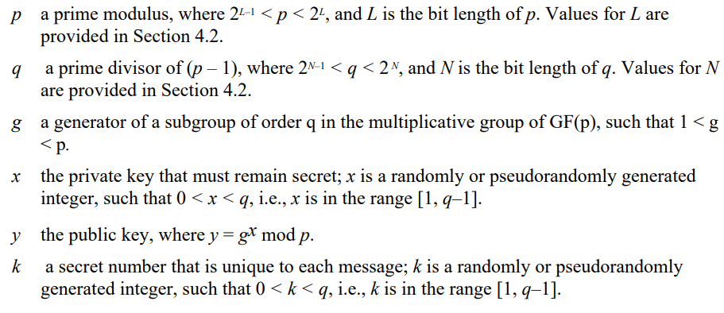
The Digital Signature Algorithm (D S A)
DSA Parameters
Notes:
The DSA is based on the difficulty of computing discrete logarithms (see Chapter 2)
and is based on schemes originally presented by Elgamal [ELGA85] and Schnorr
[SCHN91].
Figure 13.3 summarizes the algorithm.
There are three parameters that are public and can be common to a group of users. An N-bit prime number q is chosen. Next, a prime number p is selected with a length between 512 and 1024 bits such that q divides (p - 1). Finally, g is chosen to be of the form h^{(p-1)/q} mod p, where h is an integer between 1 and (p - 1) with the restriction that g must be greater than 1. Thus, the global public-key components of DSA are the same as in the Schnorr sig- nature scheme.
With these parameters in hand, each user selects a private key and generates a public key. The private key x must be a number from 1 to (q - 1) and should be chosen randomly or pseudorandomly. The public key is calculated from the private key as y = g^{x} mod p. The calculation of y given x is relatively straight- forward. However, given the public key y, it is believed to be computationally infeasible to determine x, which is the discrete logarithm of y to the base g, mod p (see Chapter 2).
The signature of a message M consists of the pair of numbers r and s, which are functions of the public key components (p, q, g), the user’s private key (x), the hash code of the message H(M), and an additional integer k that should be generated randomly or pseudorandomly and be unique for each signing.
Let M, r′, and s′ be the received versions of M, r, and s, respectively. Verification is performed using the formulas shown in Figure 13.3. The receiver generates a quantity v that is a function of the public key components, the sender’s public key, the hash code of the incoming message, and the received versions of r and s. If this quantity matches the r component of the signature, then the signature is validated.

Slide 25
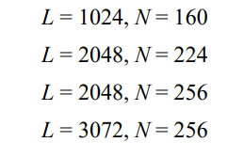
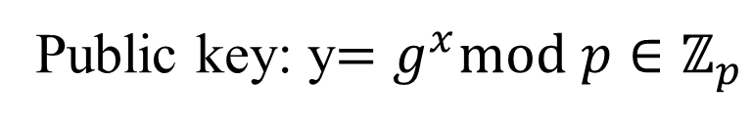
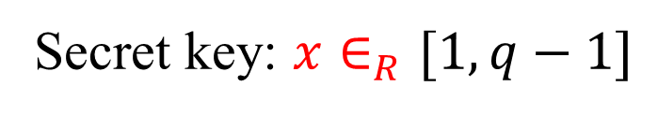


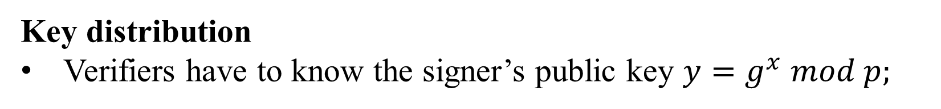

The Digital Signature Algorithm (D S A)
DSA Parameters
$2^{L−1}<p<2^{L}, p−1⋮q$
$2^{N−1}<q<2^{N}$
$$\left\langle g\right\rangle =GF\left(p\right)=ℤ_{p}$$
$$H:{\left\{0,1\right\}}^{∗}→{\left\{0,1\right\}}^{l};l≥min⁡(L,N)$$
Key generation (for signer)
Secret key: $x∈_{R}[1,q−1]$
Public key: y$=g^{x}mod p∈ℤ_{p}$
Key distribution
Verifiers have to know the signer’s public key $y=g^{x} mod p;$
Notes:
The DSA is based on the difficulty of computing discrete logarithms (see Chapter 2)
and is based on schemes originally presented by Elgamal [ELGA85] and Schnorr
[SCHN91].
Figure 13.3 summarizes the algorithm.
There are three parameters that are public and can be common to a group of users. An N-bit prime number q is chosen. Next, a prime number p is selected with a length between 512 and 1024 bits such that q divides (p - 1). Finally, g is chosen to be of the form h^{(p-1)/q} mod p, where h is an integer between 1 and (p - 1) with the restriction that g must be greater than 1. Thus, the global public-key components of DSA are the same as in the Schnorr sig- nature scheme.
With these parameters in hand, each user selects a private key and generates a public key. The private key x must be a number from 1 to (q - 1) and should be chosen randomly or pseudorandomly. The public key is calculated from the private key as y = g^{x} mod p. The calculation of y given x is relatively straight- forward. However, given the public key y, it is believed to be computationally infeasible to determine x, which is the discrete logarithm of y to the base g, mod p (see Chapter 2).
The signature of a message M consists of the pair of numbers r and s, which are functions of the public key components (p, q, g), the user’s private key (x), the hash code of the message H(M), and an additional integer k that should be generated randomly or pseudorandomly and be unique for each signing.
Let M, r′, and s′ be the received versions of M, r, and s, respectively. Verification is performed using the formulas shown in Figure 13.3. The receiver generates a quantity v that is a function of the public key components, the sender’s public key, the hash code of the incoming message, and the received versions of r and s. If this quantity matches the r component of the signature, then the signature is validated.

Slide 26
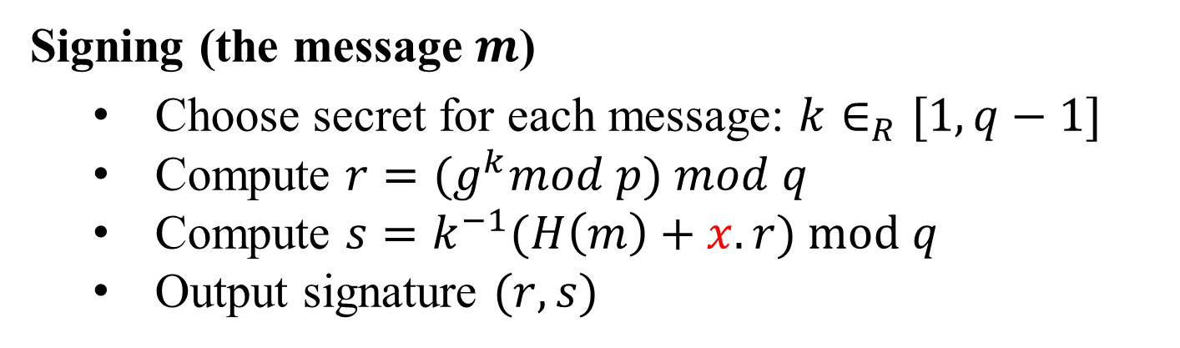
The Digital Signature Algorithm (D S A)
Signing (the message $m$)
  Choose secret for each message: $k∈_{R}[1,q−1]$
  Compute $r={(g}^{k}mod p) mod q$
  Compute $s=k^{−1}(H\left(m\right)+x.r) mod q$
  Output signature $(r,s)$

Slide 27
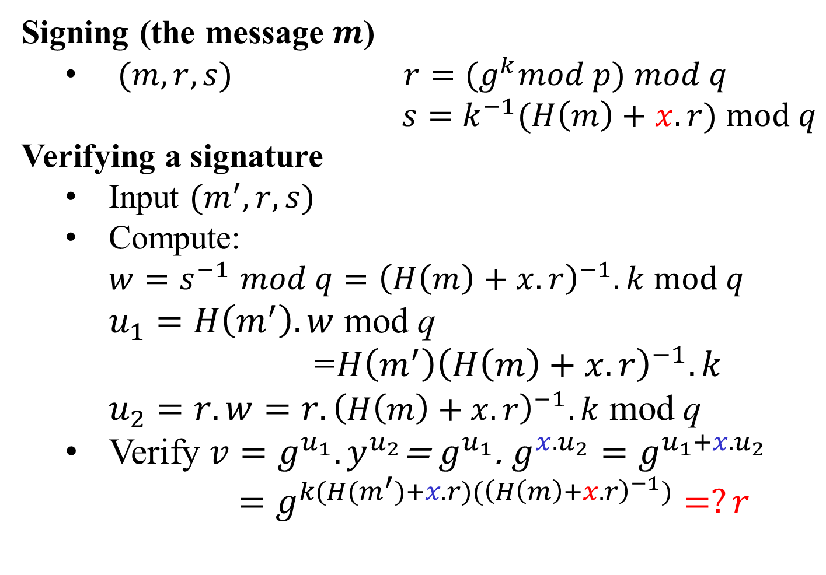
The Digital Signature Algorithm (D S A)
Signing (the message $m$)
  $(m, r,s)$ $r={(g}^{k}mod p) mod q$
  $s=k^{−1}(H\left(m\right)+x.r) mod q$
Verifying a signature
  Input $(m^{′},r,s)$
  Compute:
$w{=s}^{−1}mod q={\left(H\left(m\right)+x.r\right)}^{−1}.k mod q$
  $u_{1}=H\left(m^{′}\right).w$ mod q
  =${H\left(m^{′}\right)\left(H\left(m\right)+x.r\right)}^{−1}.k$
  $u_{2}=r.w=r.{\left(H\left(m\right)+x.r\right)}^{−1}.k$ mod q
  Verify $v=g^{u_{1}}.y^{u_{2}}$= $g^{u_{1}}$. $g^{{x.u}_{2}}=g^{u_{1}+x.u_{2}}$
  $=g^{k(H(m^{′})+x.r)({\left(H\left(m\right)+x.r\right)}^{−1})}=?r$
In public key
Secret key

Slide 28
Outline
Motivations
Overview of the digital signature process
Elgamal digital signature scheme
Schnorr digital signature scheme
NIST digital signature schemes
  RSASSA-PKCS, RSASSA-PSS
  DSA,ECDSA
Public key distribution (X.509 digital certificates)

Slide 29
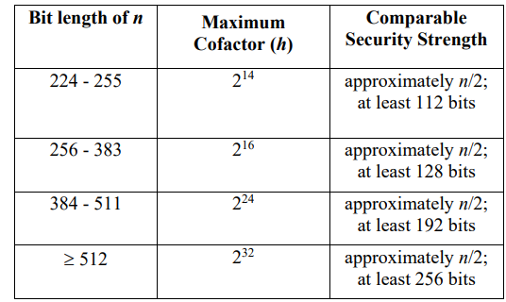
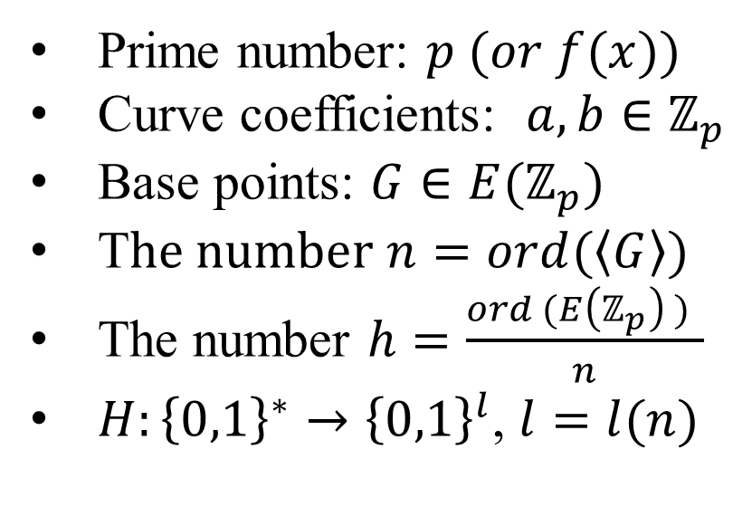
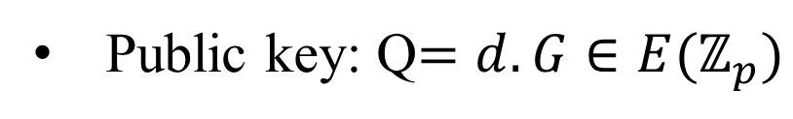
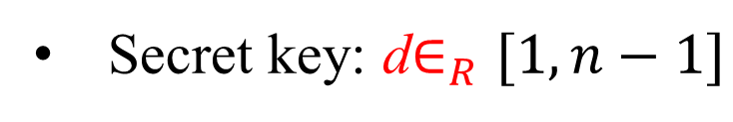
Elliptic Curve Digital Signature Algorithm (E C D S A)
ECDSA parameters
Prime number: $p (or f(x))$
Curve coefficients: $a,b∈ℤ_{p}$
Base points: $G∈E(ℤ_{p})$
T$he number n=ord(\left\langle G\right\rangle )$
The number $h=\frac{ord (E\left(ℤ_{p}\right) ) }{n}$
$H:{\left\{0,1\right\}}^{∗}→{\left\{0,1\right\}}^{l}$, $l=l(n)$
Key generation (for signer)
Secret key: d$∈_{R}[1,n−1]$
Public key: Q$=d.G∈E(ℤ_{p})$
NIST.FIPS.186-5
Key distribution: Curve, Q
Notes:
The DSA is based on the difficulty of computing discrete logarithms (see Chapter 2)
and is based on schemes originally presented by Elgamal [ELGA85] and Schnorr
[SCHN91].
Figure 13.3 summarizes the algorithm.
There are three parameters that are public and can be common to a group of users. An N-bit prime number q is chosen. Next, a prime number p is selected with a length between 512 and 1024 bits such that q divides (p - 1). Finally, g is chosen to be of the form h^{(p-1)/q} mod p, where h is an integer between 1 and (p - 1) with the restriction that g must be greater than 1. Thus, the global public-key components of DSA are the same as in the Schnorr sig- nature scheme.
With these parameters in hand, each user selects a private key and generates a public key. The private key x must be a number from 1 to (q - 1) and should be chosen randomly or pseudorandomly. The public key is calculated from the private key as y = g^{x} mod p. The calculation of y given x is relatively straight- forward. However, given the public key y, it is believed to be computationally infeasible to determine x, which is the discrete logarithm of y to the base g, mod p (see Chapter 2).
The signature of a message M consists of the pair of numbers r and s, which are functions of the public key components (p, q, g), the user’s private key (x), the hash code of the message H(M), and an additional integer k that should be generated randomly or pseudorandomly and be unique for each signing.
Let M, r′, and s′ be the received versions of M, r, and s, respectively. Verification is performed using the formulas shown in Figure 13.3. The receiver generates a quantity v that is a function of the public key components, the sender’s public key, the hash code of the incoming message, and the received versions of r and s. If this quantity matches the r component of the signature, then the signature is validated.

Slide 30
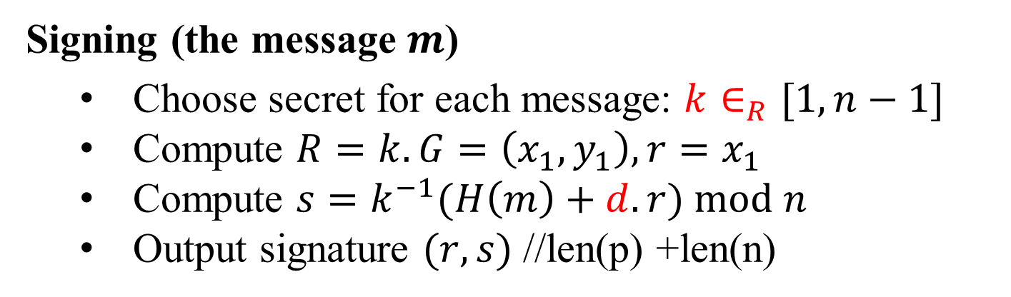
Elliptic Curve Digital Signature Algorithm (E C D S A)
Signing (the message $m$)
  Choose secret for each message: $k∈_{R}[1,n−1]$
  Compute $R=k.G=\left(x_{1},y_{1}\right), r=x_{1}$
  Compute $s=k^{−1}(H\left(m\right)+d.r) mod n$
  Output signature $(r,s)$ //len(p) +len(n)

Slide 31
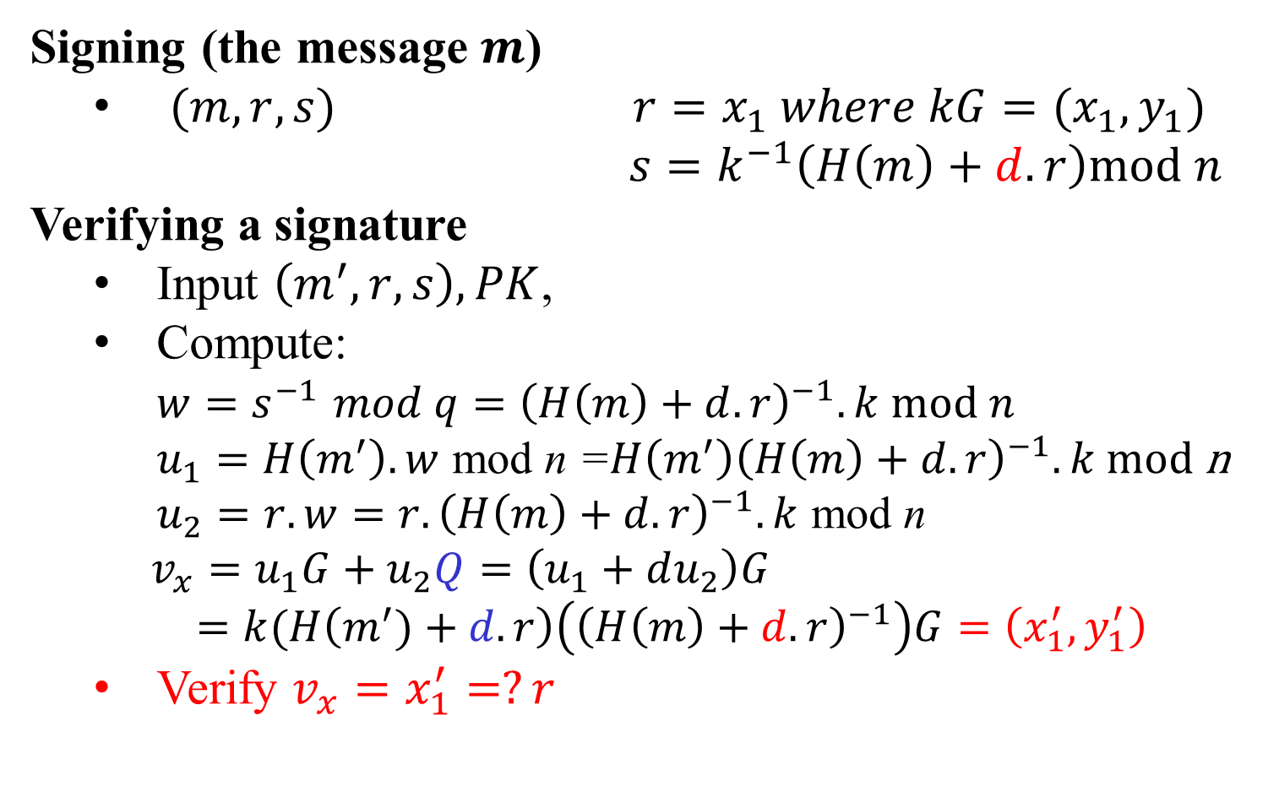
Elliptic Curve Digital Signature Algorithm (E C D S A)
Signing (the message $m$)
  $(m, r,s)$ $r=x_{1} where kG=(x_{1},y_{1})$
  $s=k^{−1}\left(H\left(m\right)+d.r\right)mod n$
Verifying a signature
  Input $\left(m^{′},r,s\right), PK$,
  Compute:
$w{=s}^{−1}mod q={\left(H\left(m\right)+d.r\right)}^{−1}.k mod n$
  $u_{1}=H\left(m^{′}\right).w$ mod n =${H\left(m^{′}\right)\left(H\left(m\right)+d.r\right)}^{−1}.k$ mod n
  $u_{2}=r.w=r.{\left(H\left(m\right)+d.r\right)}^{−1}.k$ mod n
  $v_{x}=u_{1}G+u_{2}Q=\left(u_{1}+du_{2}\right)G$
  $=k(H\left(m^{′})+d.r\right)\left({\left(H\left(m\right)+d.r\right)}^{−1}\right)G=\left(x_{1}^{′},y_{1}^{′}\right)$
  Verify $v_{x}=x_{1}^{′}=?r$
In public key
Secret key

Slide 32
Outline
Motivations
Overview of the digital signature process
Elgamal digital signature scheme
Schnorr digital signature scheme
NIST digital signature schemes
  RSASSA-PKCS
  RSASSA-PSS
  ECDSA
Public key distribution (X.509 digital certificates)

Slide 33
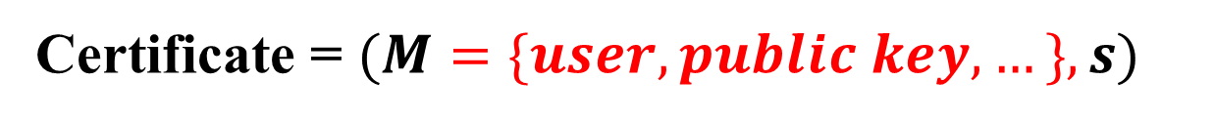
X.509 digital certificate
Certificate = $(M=\{user, public key,…\}, s)$
CERTIFICATE
Signer=Issuer
User =Subject
Subject Public Key
Issuer Digital Signature

Slide 34
X.509 digital certificate
Problems
How are Digital Certificates Issued?
Who is issuing them?
Why should I Trust the Certificate Issuer (Signers)?
How can I check if a Certificate is valid?
How can I revoke a Certificate?
Who is revoking Certificates?

Slide 35
X.509 digital certificate Formats
Version: which version the certificate is using
Serial number: a unique # assigned to the certificate within the same CA
Algorithm: name of the hash function and the public-key encryption algorithm
Issuer: name of the issuer
Validity period: time interval when the certificate is valid
Subject: name of the certificate owner
Public key: subject’s public-key and parameter info.
Extension: other information (only available in version 3)
Properties: encrypted hash value of the certificate using K_{CA}^{r}

Slide 36
Public Key Infrastructure (PKI)
PKI is a mechanism for using PKC
PKI issues and manages subscribers’ public-key certificates and CA networks (signers):
  Determine users’ legitimacy
  Issue public-key certificates upon users’ requests
  Extend public-key certificates’ valid time upon users’ requests
  Revoke public-key certificates upon users’ requests or when the corresponding private keys are compromised
  Store and manage public-key certificates
  Prevent digital signature singers from denying their signatures
  Support CA networks to allow different CAs to authenticate public-key certificates issued by other CAs

Slide 37
X.509 PKI (PKIX)
Recommended by IETF
Four basic components:
    end entity (users, verifyers)
    certificate authority (CA): responsible of issuing and revoking public-key certificates;
    registration authority (RA): verifying identities of owners of public-key certificates
    Repository: responsible of storing and managing public-key certificates
https://datatracker.ietf.org/doc/html/rfc5280
(2008, updated 2013, 2018)
Notes:
37

Slide 38
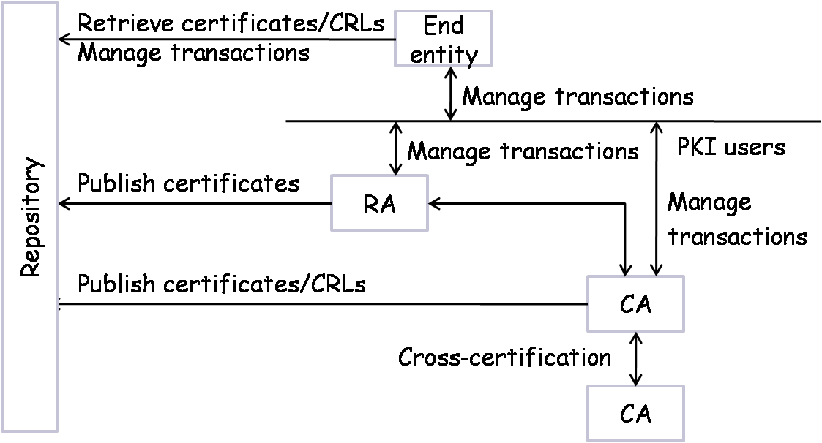
PKIX Architecture
Transaction managements:
Registration
Initialization
Certificate issuing and publication
Key recovery
Key generation
Certificate revocation
Cross-certification

Slide 39
X.509 digital certificate
Example: check digital certificate of “facebook.com”
Check server certificate
echo | openssl s_client -servername www.facebook.com -connect www.facebook.com:443 2> 1.txt | openssl x509 -text
Dowload server cert
echo | openssl s_client -servername www.facebook.com -connect www.facebook.com:443 2>1 | openssl x509 -out facebook.cer -text
Check server cert file
openssl x509 -in facebook.cer -inform pem -text -noout
https://www.openssl.org/docs/man1.1.1/man1/openssl-s_client.html
https://www.openssl.org/docs/man1.1.1/man1/openssl-x509.html

Slide 40
CA Technology Evolution
CA
CA
CA
CA
Directory
Services
CA
RA
CA
CA
CA
RA
RA
Internet
RA
RA
RA
Internet
LRA
LRA
openssl s_client -connect facebook.com:443 -showcerts

Slide 41
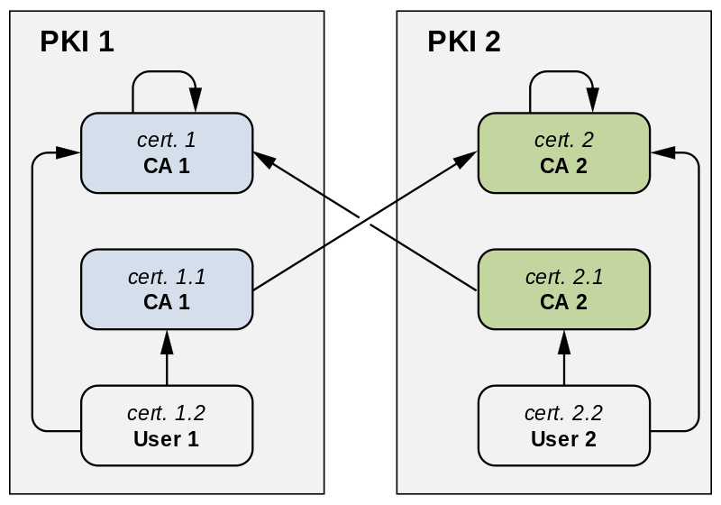
Cross-certification between two PKIs

Slide 42
Attack terminology on digital signature
Key-only attack
  Attackers only knows signer’s public key
Known message attack
  Attackers is given access to a set of messages and their signatures

Slide 43
Attack terminology on DS
Generic chosen message attack
  Attackers chooses a list of messages before attempting to break signer’s signature scheme (independent of signer’s public key);
  Attackers then obtains from signer valid signatures for the chosen messages;

Slide 44
Attack terminology on DS
Directed chosen message attack
  Similar to the generic attack, except that the list of messages to be signed is chosen after attackers knows signer's public key but before any signatures are seen;
Adaptive chosen message attack
  attackers may request from signer signatures of messages that depend on previously obtained message-signature pairs;

Slide 45
Forgery attacks
Total break
  Attackers determines signer’s private key;
Universal forgery
  Attackers finds an efficient signing algorithm that provides an equivalent way of constructing signatures on arbitrary messages;
Selective forgery
  Attackers forges a signature for a particular message chosen by signer;
Existential forgery
  Attackers forges a signature for at least one message; Attackers has no control over the message;

Slide 46
Digital Signature Requirements
The signature must be a bit pattern that depends on the message being signed;
The signature must use some information unique to the sender to prevent both forgery and denial;
It must be relatively easy to produce the digital signature;
It must be relatively easy to recognize and verify the digital signature;
It must be computationally infeasible to forge a digital signature, either by constructing a new message for an existing digital signature or by constructing a fraudulent digital signature for a given message;
It must be practical to retain a copy of the digital signature in storage;

Slide 47
Direct Digital Signature
Direct Digital signature scheme involves only the communicating parties
  It is assumed that the destination knows the public key of the source;
Confidentiality: encrypting the entire message + signature with a shared secret key
  It is important to perform the signature function first and then an outer confidentiality function
  In case of dispute some third party must view the message and its signature;
The validity of the scheme depends on the security of the sender’s private key
  If a sender later wishes to deny sending a particular message, the sender can claim that the private key was lost or stolen and that someone else forged his or her signature;
  One way to thwart or at least weaken this ploy is to require every signed message to include a timestamp and to require prompt reporting of compromised keys to a central authority

